Slide 1

Accounting Information System
2
Day
#3
Chapter
UAA – ACCT 201 Principles of Financial Accounting Dr. Fred Barbee

Slide 2
Accounting Information System
2
Chapter
First . . . A brief review of Day #2 Topics.

Slide 3
Debits and
Credits
ACCT 201 ACCT 201 ACCT 201

Slide 4

Debits and Credits
The debit/credit convention or coding system is very simple.
Do not make it difficult because you cannot accept its simplicity.

Slide 5
Debits
Debit comes from Latin and merely means “left,” or the “left-hand” side of an account. Abbreviated “DR.”

Slide 6

Account Title
Left Side
We need to stop here and change our way of thinking!
Debit Side

Slide 7

Symbolically, let’s erase that memory
C:\memory\debit\erase *.*
All files in directory will be deleted
Are you sure (Y/N)?

Slide 8
Credits
Credit also comes from the Latin, and means “right,” or the “right-hand” side of an account. Abbreviated “CR.”

Slide 9
Account Title
Right Side
Let’s stop here and modify our thinking – at least for this class!
Credit Side

Slide 10
Symbolically, let’s erase that memory
C:\memory\credit\erase *.*
All files in directory will be deleted
Are you sure (Y/N)?

Slide 11
The algebraic relationship in the fundamental accounting model.
Assets
ACCT 201 ACCT 201 ACCT 201
=
Liabilities
Owners’ Equity
+

Slide 12
Account Title
Debit
Credit
ACCT 201 ACCT 201 ACCT 201
Always

Slide 13
=
Assets
DR
CR
Liabilities
+
+
-
Owners’ Equity
DR
CR
-
+
DR
CR
-
+

Slide 14
The Second Equality . . .
Debits
Credits
=
ACCT 201 ACCT 201 ACCT 201
The algebraic relationship between account increases and decreases.

Slide 15
Debit-Credit Rules . . .
Account
Inc.
Dec.
Assets
Debit
Credit
Liabilities
Credit
Debit
Owners’ Equity
Credit
Debit
Revenue
Credit
Debit
Expenses
Debit
Credit

Slide 16
Debit-Credit Rules . . .
Debits
Credits
Increase
Assets
Expenses
Liabilities
Equity
Revenue
Decrease
Liabilities
Equity
Revenue
Assets
Expenses

Slide 17

ncrease
ebits
IDEA
xpenses
ssets

Slide 18

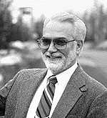
evenues
quity
RELIC
iabilities
ncrease
redits

Slide 19


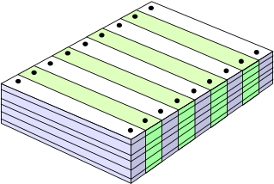
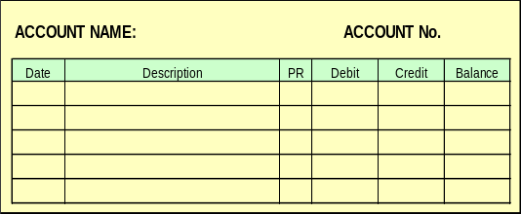
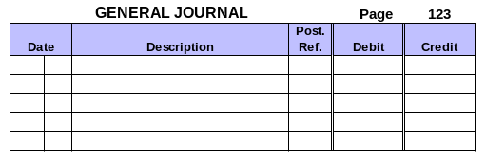
Steps in Processing Transactions
=
+
Assets
Liabilities
Equity
Step 1: Examine source documents.
Step 2: Analyze transactions.
Step 5: Prepare a trial balance.
Step 3: Record transactions in a journal.
Step 4: Record the journal information in a ledger.

Slide 20
The Journal
ACCT 201 ACCT 201 ACCT 201
General Journal |  |  |  |  | Page 1
Date |  | Description | PR | Debit | Credit
Jan | 6 | Art Supplies |  | 1,800
 |  | Office Supplies |  | 800
 |  | Accounts Payable |  |  | 2,600
 | Purchase of art and office supplies on credit
Notes:
Journals
A journal contains a chronological record of the transactions of a business. Because each transaction is initially recorded in a journal before being entered in the ledger, a journal is called a book of original entry.
Here every business transaction is analyzed for its effects upon the entity. These effects are expressed in terms of debit and credit - the inputs of the accounting system.

Slide 21
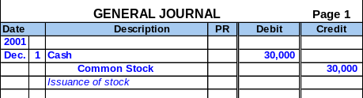
General Journal for FastForward
Transaction Date
Titles of Affected Accounts
Transaction explanation
Dollar amount of debits and credits

Slide 22
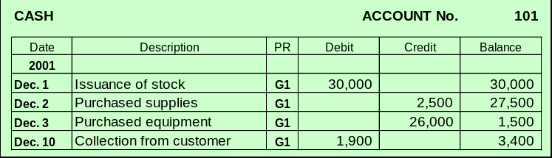
Balance Column Ledger
T-accounts are useful illustrations, but balance column ledger accounts are used in practice.

Slide 23
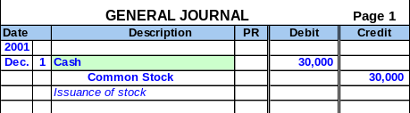
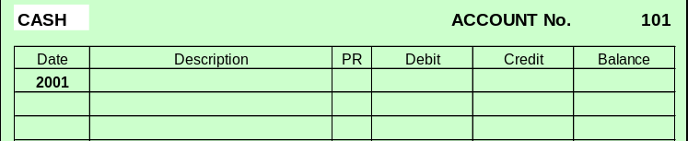
Posting Journal Entries - Example
1
Identify the account.

Slide 24
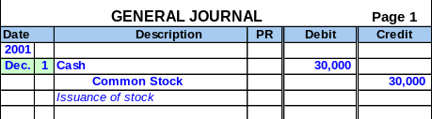
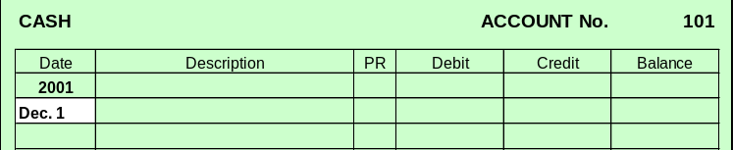
Posting Journal Entries - Example
Enter the date.
2

Slide 25
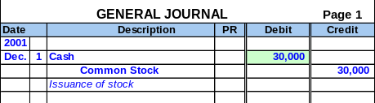
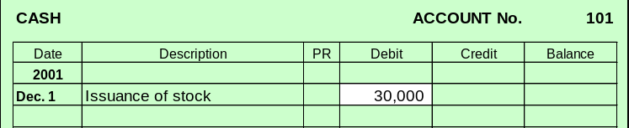
Posting Journal Entries - Example
Enter the amount.
3

Slide 26
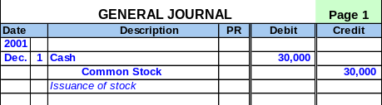
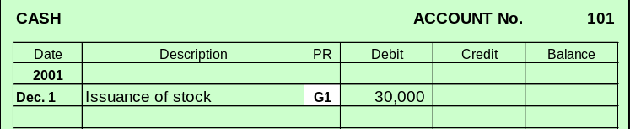
Posting Journal Entries - Example
Enter the journal reference.
4

Slide 27
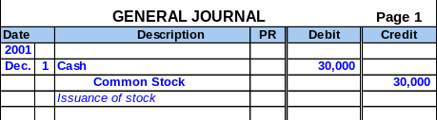
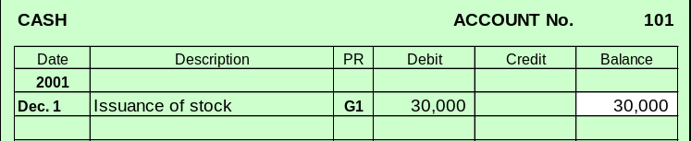
Posting Journal Entries - Example
Compute the balance.
5

Slide 28
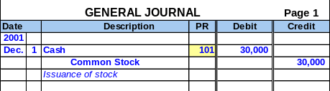
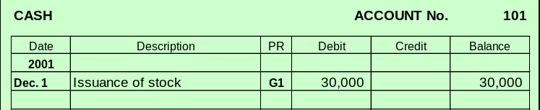
Posting Journal Entries - Example
Enter the ledger reference.
6

Slide 29
Accounting Information System
2
Chapter
Text Section:
Trial Balance (p. 63)

Slide 30


Learning Objective
P2
  Prepare and explain the use of a trial balance.
Procedural

Slide 31
Trial Balance
A Trial Balance is a listing of all accounts and their balances at a point in time.

Slide 32
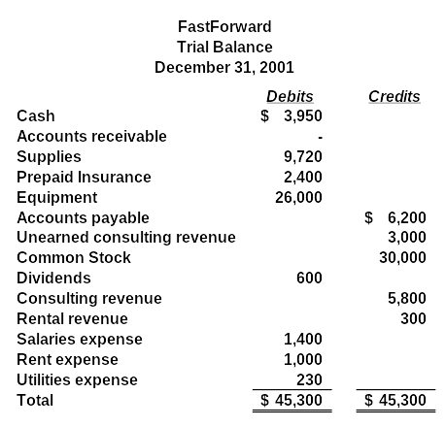

Slide 33
Accounting Information System
2
Chapter
Text Section:
Unadjusted Financial Statements (p. 68)

Slide 34
Learning Objective
P3
  Prepare unadjusted financial statements from business transactions.
Procedural

Slide 35

Income Statement
A statement showing revenues and expenses for a period of time.
  Revenues = Inflows of assets in exchange for products and services provided to customers.
  Expenses = Outflows or the using up of assets that result from providing products and services to customers.

Slide 36
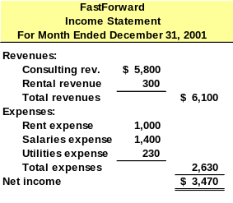
Exh.
2.19
Notes:
3

Slide 37
Statement of Retained Earnings
A statement showing additions to (net income) and deductions from (net loss, dividends) the Retained Earnings account.

Slide 38
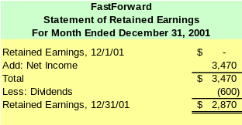
Exh.
2.19
Notes:
6

Slide 39
Balance Sheet
A statement showing the balances in asset, liability, and equity accounts at a point in time.

Slide 40
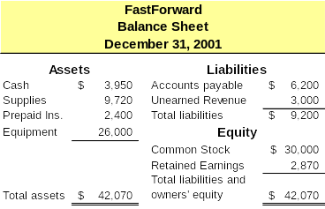
Exh.
2.19
Notes:
8

Slide 41


Statement of Cash Flows
A statement showing the sources and uses of funds relating to the
  Operating
  Investing, and
  Financing
Activities of a company.

Slide 42
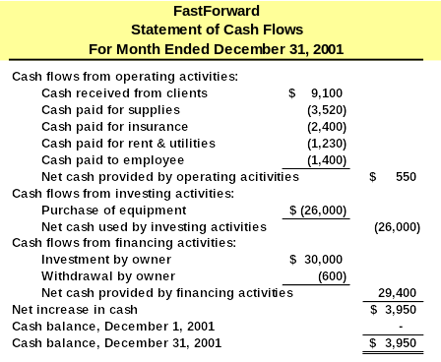
Exh.
2.19
Notes:
14

Slide 43
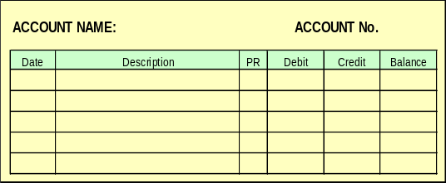
Formatting Conventions
Generally, dollar signs ($) are not used in the journals or ledgers.
Round numbers in financial statements to the nearest dollar.
Rounding

Slide 44
Accounting Information System
2
Chapter
Text Section:
Decision Analysis (p. 70)

Slide 45
Learning Objective
A2
  Analyze the impact of transactions on accounts and financial statements.
Analytical

Slide 46
Learning Objective
A3
  Compute return on equity and use it to analyze company performance.
Analytical

Slide 47

Using the Information - Return on Equity
Describes the relationship between net income for the period and average equity.
Helps an owner judge the compnay’s profitability compared to other business or personal opportunities.

Slide 48
Learning Objective
A4
  Compute the debt ratio and describe its use in analyzing company performance.
Analytical

Slide 49

The End

